Slide 1
Steps for assembling and disassembling

Slide 2
Supervisor: Sir Jeff
Course code: ICTU 1101
Course tittle: PC HARDWARE
Semester: Fall 2023

Slide 3
Name: Nyuydze Delcon Suika
Matricule: ICTU20233986
Level and group; Level 1, Group 5
Group of practicals: Group 2 Team H

Slide 4
Overview
Introduction
System unit assembly
Motherboard Installation
CPU Installation
Memory Module Installation
Storage Device installation
Power Supply Connection
Cable Management
Final checks
Conclusion

Slide 5
Introduction
This report provides a comprehensive overview of the process involed in assembling and disassembling a system unit. The system unit is a critical component of a computer as well as the motherboard, CPU, memory modules, and storage devices. Understanding the steps for both assembly and disassembly is crucial for various purposes, including upgrades, maintainance, and troubleshooting.

Slide 6
I.System unit assembly

Slide 7
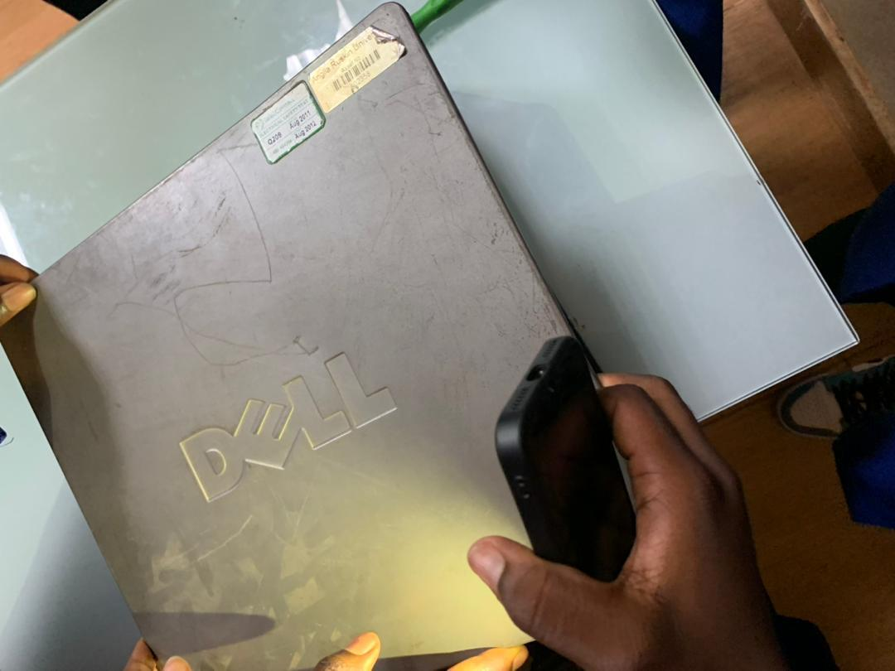
A.Preliminary Preparations:
Ensures a clean and well-lit workspace.
Gather all necessary components and tools..

Slide 8
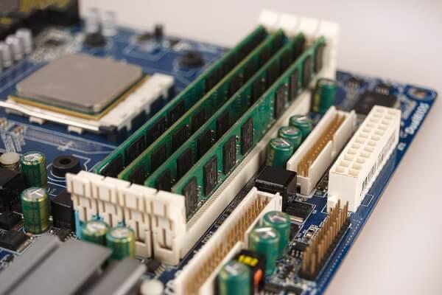
B.Motherboard Installation
Identify the motherboard and align it with the case.
Secure the motherboard to the case using screws

Slide 9
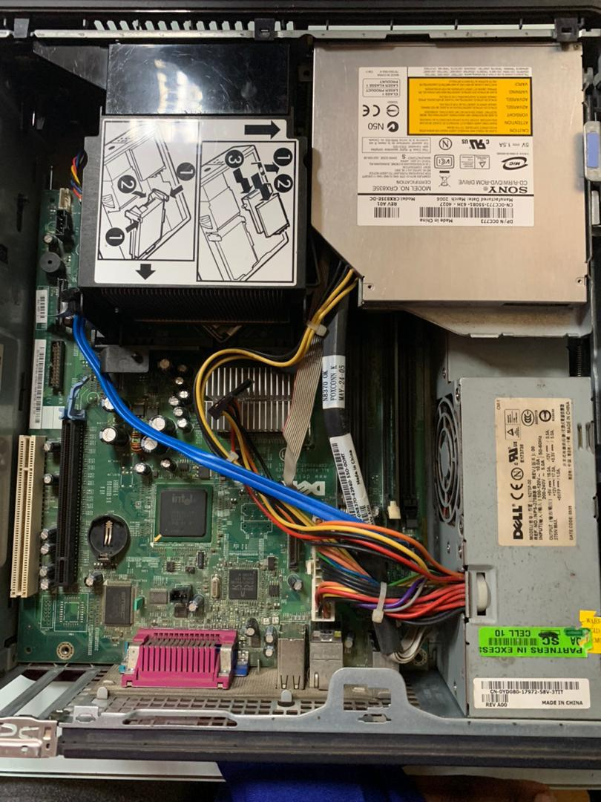
C.CPU Installation:
Identify the CPU socket on the motherboard.
Align the CPU correctly and secure it in place

Slide 10
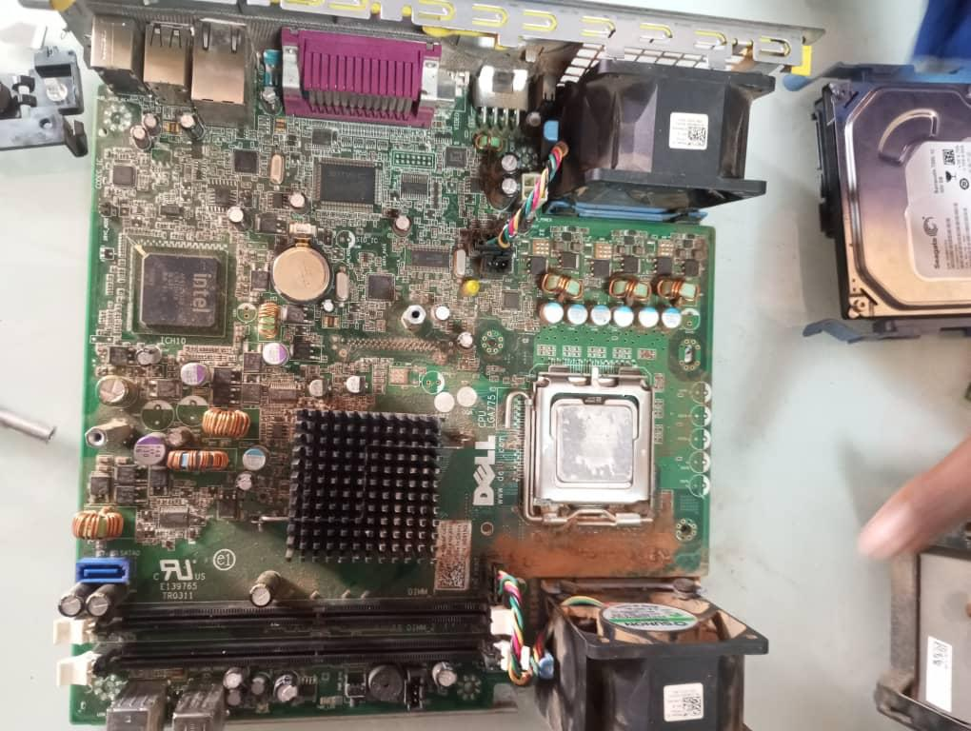
D. Memory Module installation
Identify the memory slots on the motherboard.
Insert the memory modules into the slots until they click into place.

Slide 11
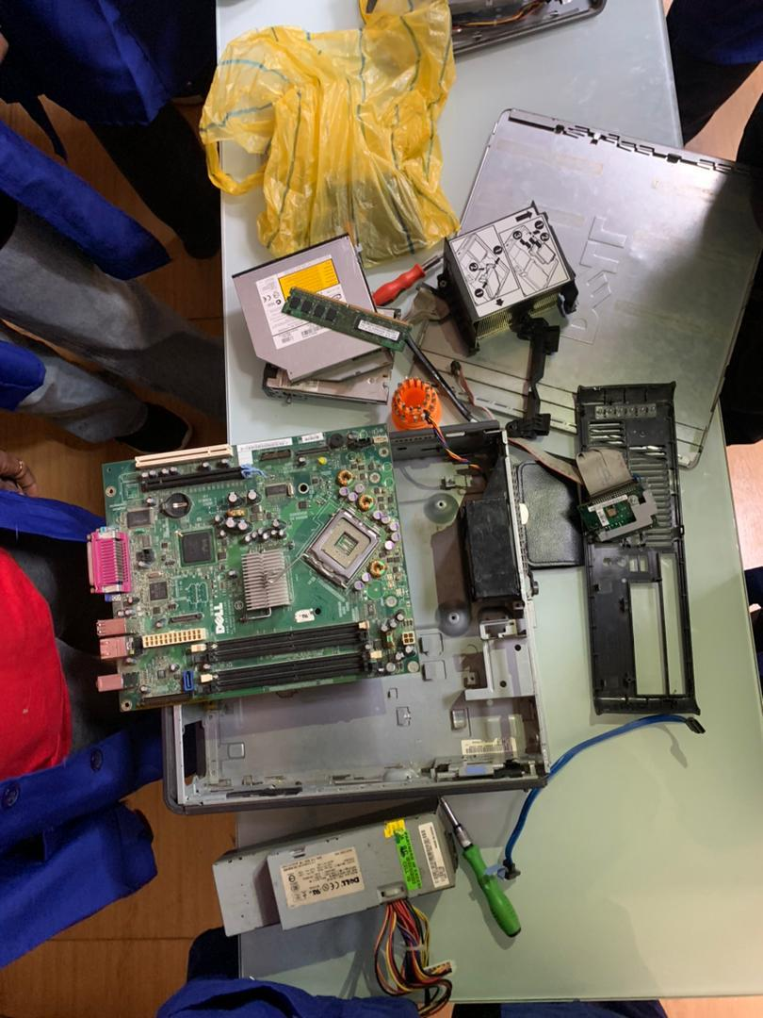
E. Storage Device installation:
Identify the storage bays in the case.
Install the hard drives.

Slide 12
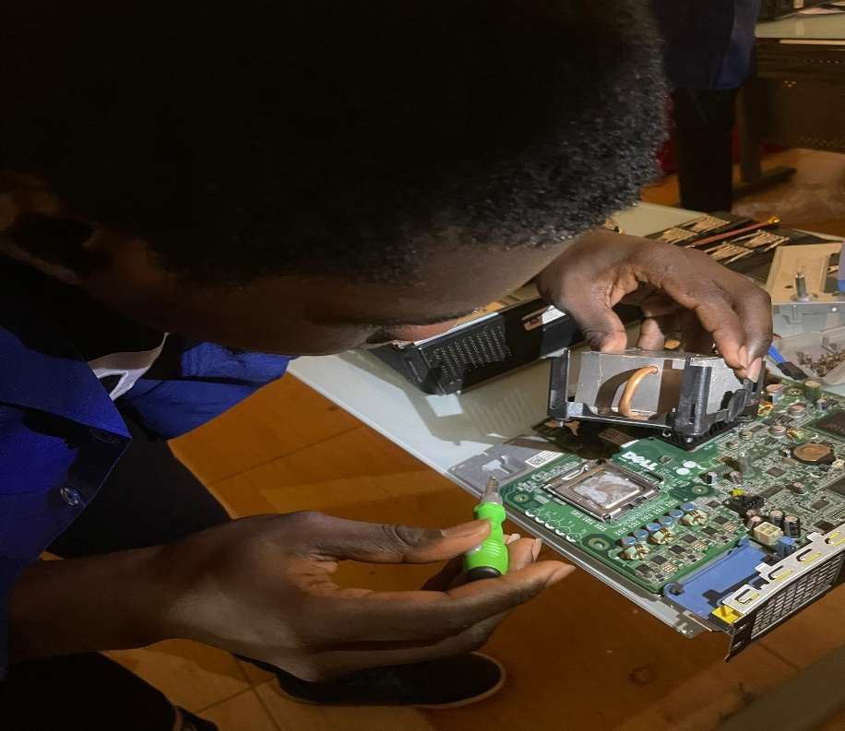
F. Power Supply Connection.
Connect the power supply to the motherboard and other components.
Ensure all power cables are securely connected.

Slide 13
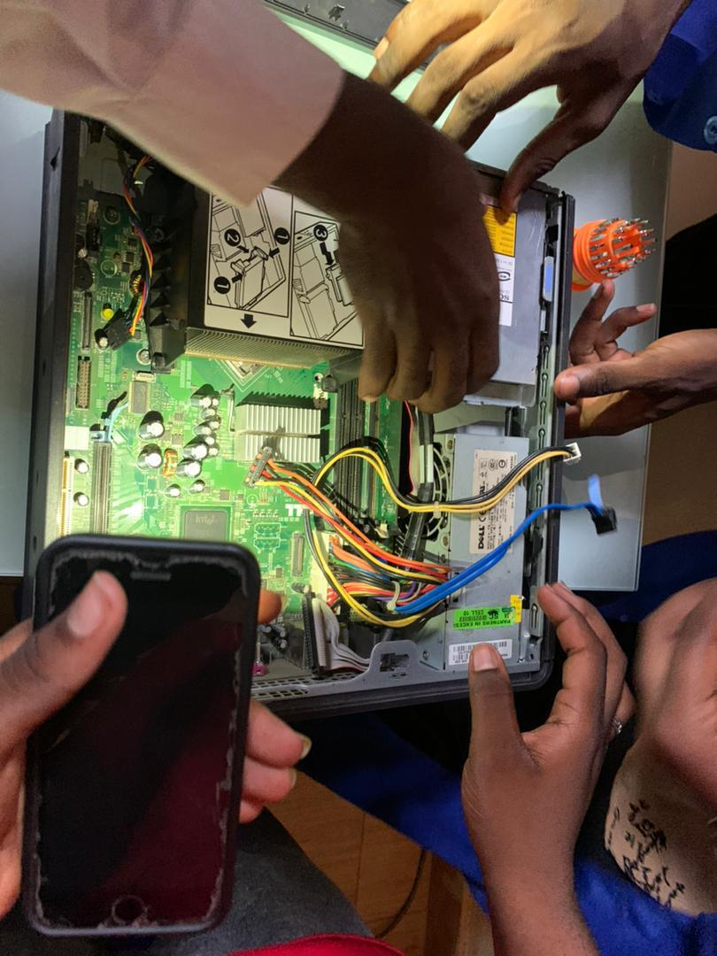
G. Cable Management
Organize and secure cables to improve airflow and aesthetics.

Slide 14
II. System Unit Disassembly:

Slide 15
A. Power Down and Disconnect:
Shut down the computer and disconnect all power sources.
Ensure proper grounding to prevent electrostatic discharge.

Slide 16
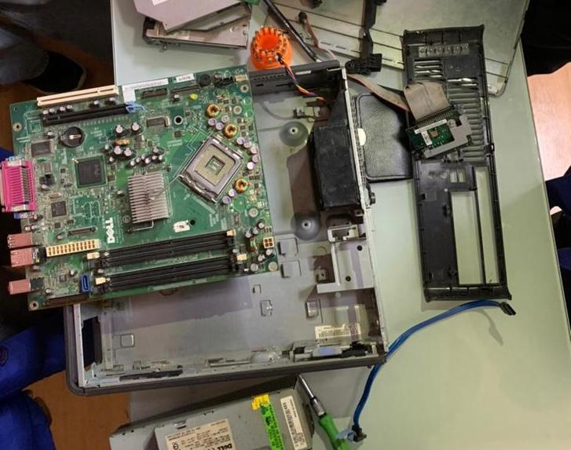
B. Cable Removal:
Disconnect all cables attached to the system unit.

Slide 17
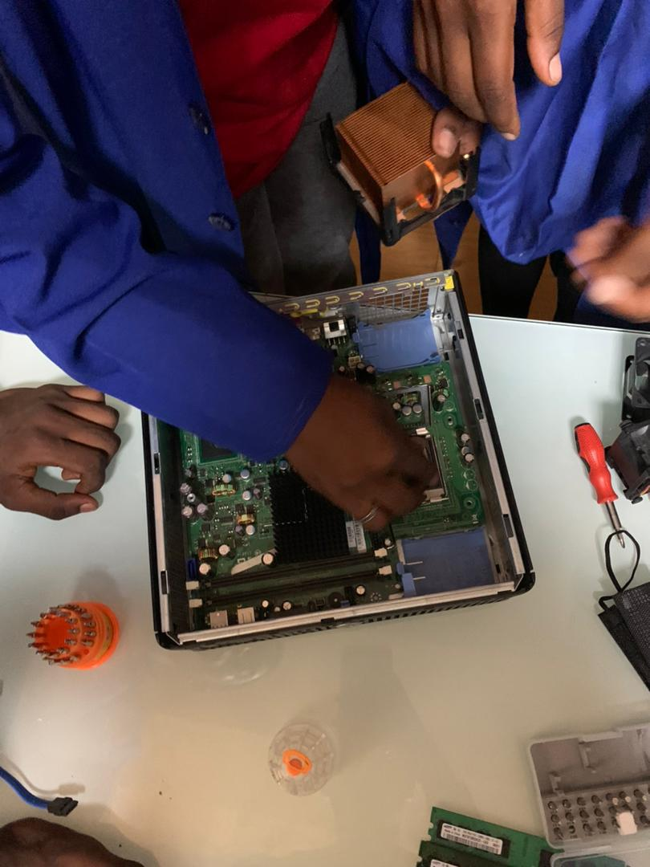
C. Storage Device Removal:
Disconnect and remove hard drives or SSDs.

Slide 18
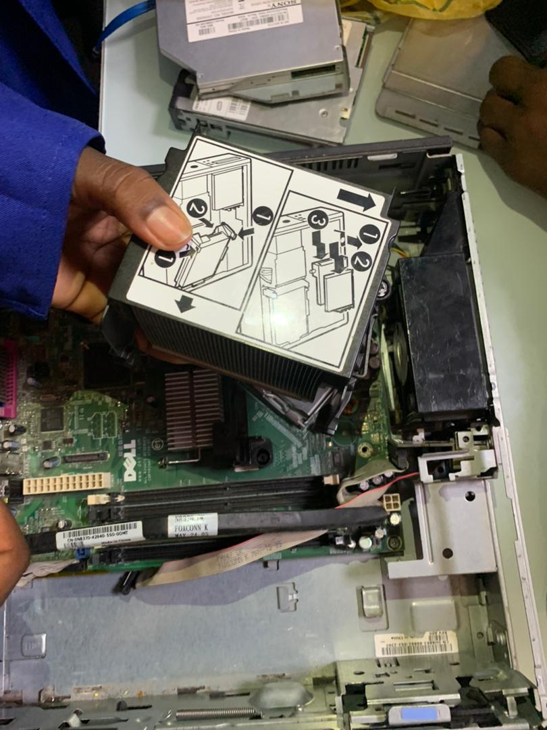
D. Memory Module Removal:
Release the clips securing the memory modules and carefully remove them.

Slide 19
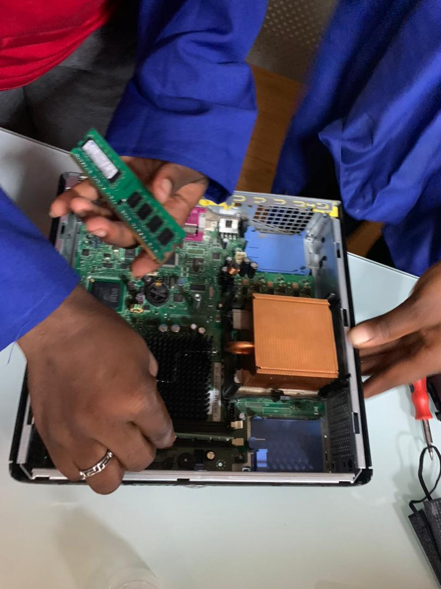
E. CPU Removal:
Unlock the CPU socket and gently remove the CPU.

Slide 20
F. Motherboard Removal:
Unscrew the motherboard from the case and carefully lift it out.

Slide 21
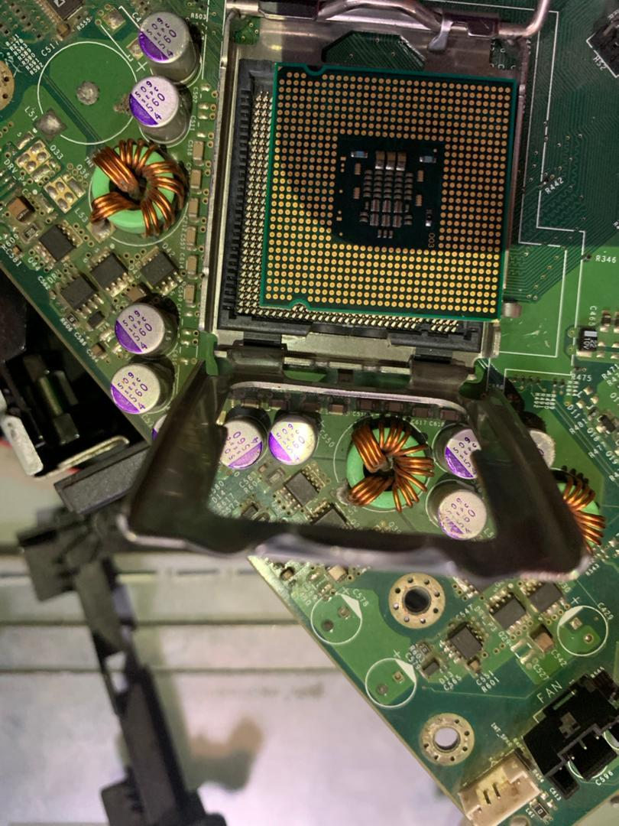
G. Final Checks:
Inspect components for damage.
Store components in an anti-static bag if necessary.

Slide 22
Conclusion:
This report provides a step-by-step guide for both assembling and disassembling a system unit, ensuring a systematic and safe process. Following these procedures it is essential for effective system maintainance, upgrades, and troubleshooting.

